Slide 1
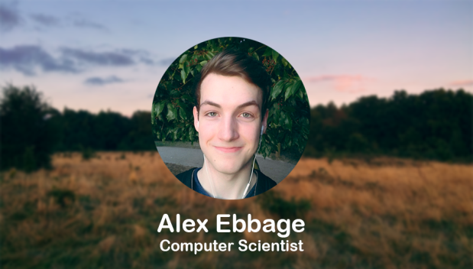

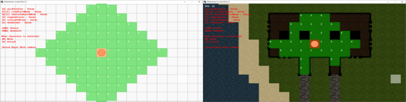




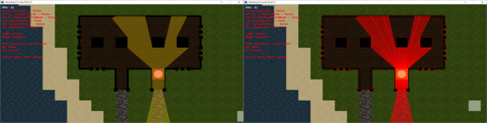
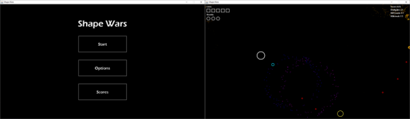
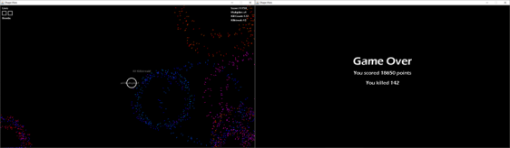
About Portfolio Contact
About Portfolio Contact
About Portfolio Contact
Projects.
The other languages I am familiar with are SQL, C++, C#, HTML5 and CSS.
Applications I am familiar with are Photoshop CS5, Blender, GIMP, Microsoft Office, Unity and Unreal Engine.
Shape Shooter
Shape Shooter is the first game I made, it was programmed in Java and took about 2 months to finish. I learnt a lot over the course of the project and it kindled my passion for making applications and games.
Introduction
Hobbies
My name is Alex Ebbage, I’m 21 years old and currently in my 2nd year of study on a BSc Computer Science degree at Essex University.
I am passionate about developing both applications and games, and hope to specialize down this road later in my course. I recently started making games as a hobby and have made a simple twin-stick style shooter. Currently I am working on a multiplayer DnD style game to play with my friends.
Some of the things I like to do in my free time consist of playing games, cooking, rock climbing.
© Copyright 2016 - Alex Ebbage - Last modified 7/12/16
DnD Project
I started this project because I wanted to make it more convenient for my friends and I to play DnD whilst attending different universities. It’s been a steep learning curve but I’m loving it.
Skills
The languages I am experienced using are Python and Java, but currently use Java for most of my

Slide 2
Navigation Bar
Navigation
-The selected option will be coloured to provide feedback.
-External navigation links can be found at the bottom of each page on a bar.
-The external navigation links are represented by icons. The icons relate to the link location; i.e. the LinkedIn logo icon will take the user to my LinkedIn page.
Layout
-The navigation bar will be fixed at the top of the page. -The navigation icons will be centred on the bar.
-There will be an image banner on my main page, showing my picture and name.
-Each piece of content will have a header bar and a contents block.
-The external links navigation bar will be below all of the contents.
-There will be a footer below the external navigation bar.
-White space will divide the content from the image banner, other content and the external links.
Colours and Imagery
-The navigation bars and content headers will be a dark and desaturated blue. (#2F3B45)
-The contents blocks will be a lighter colour than the navigation bars. (#485B6A)
-The image banner will use a picture that I took whilst hiking and a picture of me overlaying it.
-Images of the company logo will be used for the external links.
-The portfolio page will use screenshotted images from my games.
-The hover colour for navigation links and icons will be blue. (#00B0F0)
Font
-The pages will only use Arial font.
-The font will all be white, other than the hovering navigation link which will be blue.(#00B0F0)
Contents
-The information on the pages may be different from what appears on the storyboards but it won’t differ too much, and the structure will remain the same.
Image Banner
(Profile picture and name)
Content Header
Content
Content Header
Content
External Navigation Links
Footer

Slide 3

About Portfolio Contact
About Portfolio Contact
most of my projects.
The other languages I am familiar with are SQL, C++, C#, HTML5 and CSS.
Applications I am familiar with are Photoshop CS5, Blender, GIMP, Microsoft Office, Unity and Unreal Engine.
Alex Ebbage
Introduction
Hobbies
My name is Alex Ebbage, I’m 21 years old and currently in my 2nd year of study on a BSc Computer Science degree at Essex University. I have experience using Python and Java, but currently use Java for most of my projects. I am also familiar with SQL, C++, HTML5 and CSS.
I am passionate about developing both applications and games, and hope to specialize down this road later in my course. I recently started making games as a hobby and have made a simple twin-stick style shooter. Currently I am working on a multiplayer DnD style game to play with my friends.
Some of the things I like to do in my free time consist of playing games, cooking, rock climbing.
© Copyright 2016 - Alex Ebbage - Last modified 7/12/16
Skills
The languages I am experienced using are Python and Java, but currently use Java for

Slide 4
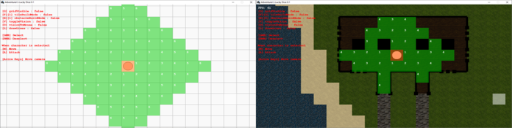

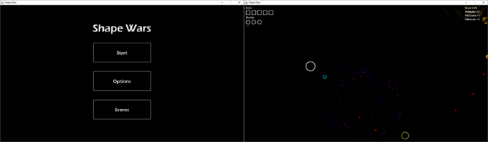

About Portfolio Contact
Shape Shooter
Shape Shooter is the first game I made, it was programmed in Java and took about 2 months to finish. I learnt a lot over the course of the project and it kindled my passion for making applications and games.
DnD Project
I started this project because I wanted to make it more convenient for my friends and I to play DnD whilst attending different universities. It’s been a steep learning curve but I’m loving it.

Slide 5
M
A
R
G
I
N
Navigation Bar
M
A
R
G
I
N
General
-The navigation and colours are the same as the mobile version.
Layout
-The content is centred the same as the mobile version.
-The column will have equal margins on either side.
-This will keep the content neatly centred in the page, instead of stretching it across the screen.
Imagery
-There are desktop and mobile versions of each image, so alternate ones will be displayed depending on the current display.
Font
-All the font will be slightly larger and the spacing will be increased slightly.
Image Banner
(Profile picture and name)
Content Header
Content
Content Header
Content
External Navigation Links
Footer

